Slide 1

Infosys_FoodTrends: Understanding Customer Preferences - Batch _11 Team C
Analyzing customer preferences using Zomato restaurant data
Name: Piyush Nitnaware
Mentor Name: Nityasree J

Slide 2



Objective of the Project
Analyze customer preferences
Identify key factors affecting ratings and popularity
Extract insights for business decision-making
Identify patterns and trends in customer behavior, preferences, and decision- making
Determine the influential variables that drive restaurant ratings and customer appeal
Provide actionable recommendations to help food platforms make strategic business decisions
The key objective of the Infosys_FoodTrends project is to analyze the Zomato restaurant dataset and derive meaningful insights that can inform strategic business decisions for food platforms.

Slide 3




Project Description
Dataset contains restaurant-level information
Performed data cleaning and preprocessing
Conducted exploratory data analysis (EDA)
Built interactive dashboards
Cleaned and preprocessed the data to address issues like missing values, inconsistent entries, and data formatting problems.
Analyzed the dataset to identify trends, patterns, and key factors affecting restaurant ratings and popularity.
Developed visualizations and dashboards to effectively communicate customer trends and preferences.
The dataset includes details such as restaurant name, cuisines, ratings, votes, cost, location, delivery options, and more.
The project involved a comprehensive analysis of the Zomato restaurant dataset, leveraging data cleaning, EDA, and interactive dashboard creation to extract valuable business insights.

Slide 4
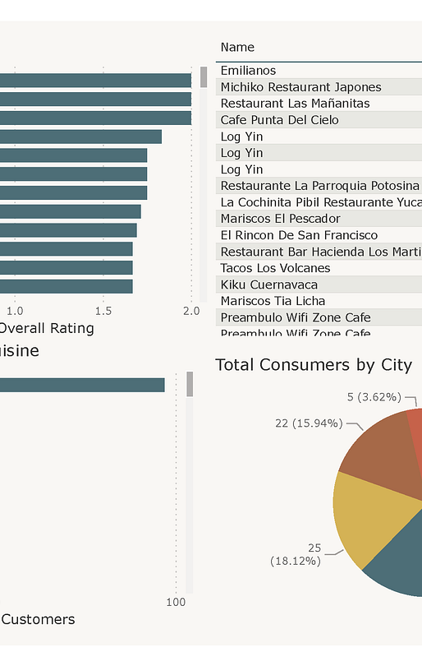
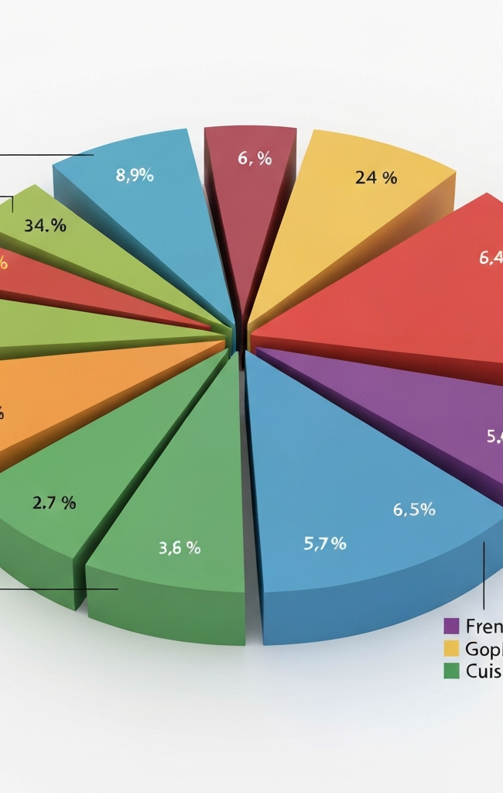
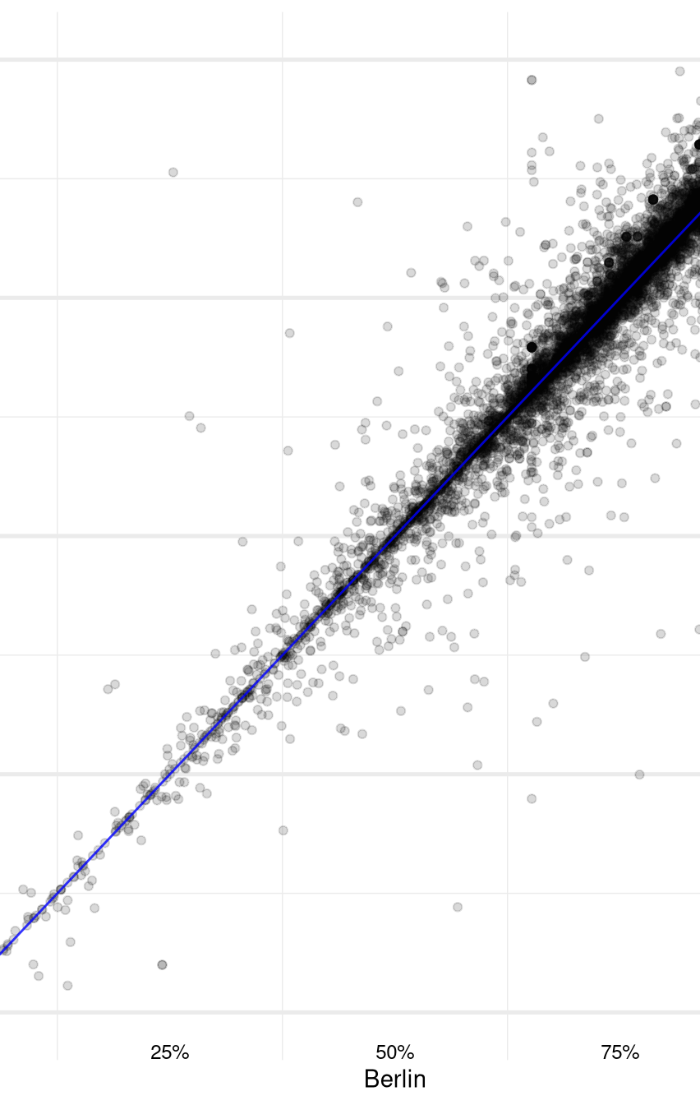
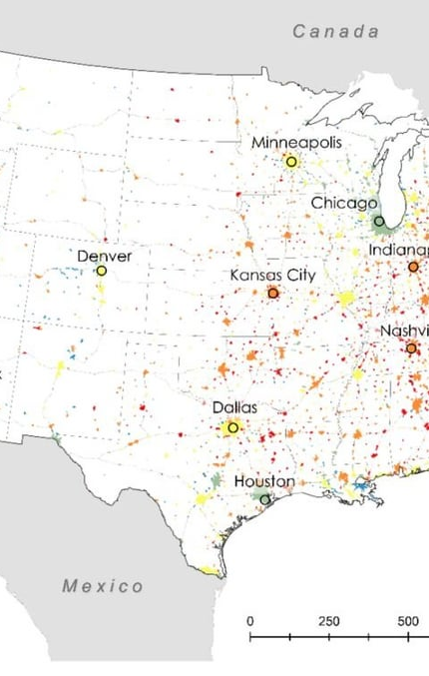
Top Visualizations Used
Ratings Distribution
Top Cuisines
Average Cost vs Rating
Online Delivery vs Rating
Location-wise Restaurant Count
Distribution of restaurant ratings
Most popular cuisine types
Relationship between average cost and rating
Impact of online delivery on restaurant ratings
Distribution of restaurants across locations

Slide 5
Project Milestones
Milestone 1
Milestone 3
Dataset collection & understanding
EDA + visualization/dashboard building
Milestone 2
Milestone 4
Data cleaning & preprocessing
Insights, conclusions & reporting

Slide 6
Challenges Faced
Missing values
Dataset contained several missing values across different fields that required thorough cleaning and imputation
Inconsistent entries
Cuisine categories, restaurant names, and other fields had high variability in formatting and terminology
High cuisine category variation
Cuisine types were highly diverse with many overlapping and ambiguous categories that needed to be consolidated
Outliers in cost and votes
Extreme outliers in restaurant cost and customer votes had to be identified and handled appropriately
Data formatting issues
Ratings and location fields had inconsistent formatting and structures that required extensive data preprocessing

Slide 7



Learnings from the Project
Improved data preprocessing skills
Enhanced exploratory data analysis (EDA)
Developed dashboard storytelling skills
Improved insight reporting capabilities
Learned techniques for handling missing values, inconsistent entries, and data formatting issues
Identified key trends and patterns in the restaurant dataset through visualization and analysis
Created interactive dashboards to effectively communicate insights and findings
Extracted actionable business recommendations from the data analysis
The Infosys_FoodTrends project helped me significantly improve my data preprocessing, EDA, dashboard creation, and insight reporting skills - key competencies for a data analyst.

Slide 8
Top Cuisine Preferences
High-Rated Restaurant Popularity
The analysis revealed that a few cuisines, such as Indian, Chinese, and Italian, consistently dominate customer demand, generating the majority of orders.
Restaurants with high ratings (4.5 and above) typically have a higher number of votes and reviews, indicating strong customer trust and popularity.
Key Insights & Future Scope
Impact of Pricing
Future Enhancements
Most customers prefer mid-range pricing options (between $10-$20 per person), suggesting that affordability is a key factor in their decision-making.
Potential future enhancements include adding machine learning- based recommendation systems, predicting restaurant ratings using feature engineering, and building interactive dashboards for enhanced data exploration.

Slide 9



Conclusion
Customer preferences influenced by cuisine, cost, delivery, and location
Visual dashboards enabled quick identification of trends
Provided business-ready insights for food platforms
Key insights from the project show that customer preferences are shaped by a combination of factors including the type of cuisine, cost of the restaurant, availability of online delivery, and the restaurant's location.
The interactive dashboards built as part of the project allowed for efficient exploration and visualization of customer trends and preferences across various data dimensions.
The project culminated in delivering actionable insights that can directly inform strategic decision-making for food platforms to better cater to their customers' needs.
The Infosys_FoodTrends project successfully leveraged the Zomato restaurants dataset to uncover valuable customer preference patterns, equipping food platforms with the necessary intelligence to enhance their offerings and drive business growth.

Slide 10
Acknowledgement & References
Acknowledgement
References
I would like to express my sincere gratitude to my mentor for there valuable guidance and continuous support throughout this project.
I also thank the Infosys team for providing the opportunity and learning environment to work on this project.
Special thanks to Kaggle and the data contributors for making the dataset publicly available.
Restaurants Dataset, Kaggle https://www.kaggle.com/datasets/yashsahu02/zomato-restaurants- dataset
Zomato platform (for domain understanding)
Project dashboards and analysis created during the study

Slide 11
Thank You

